Slide 1
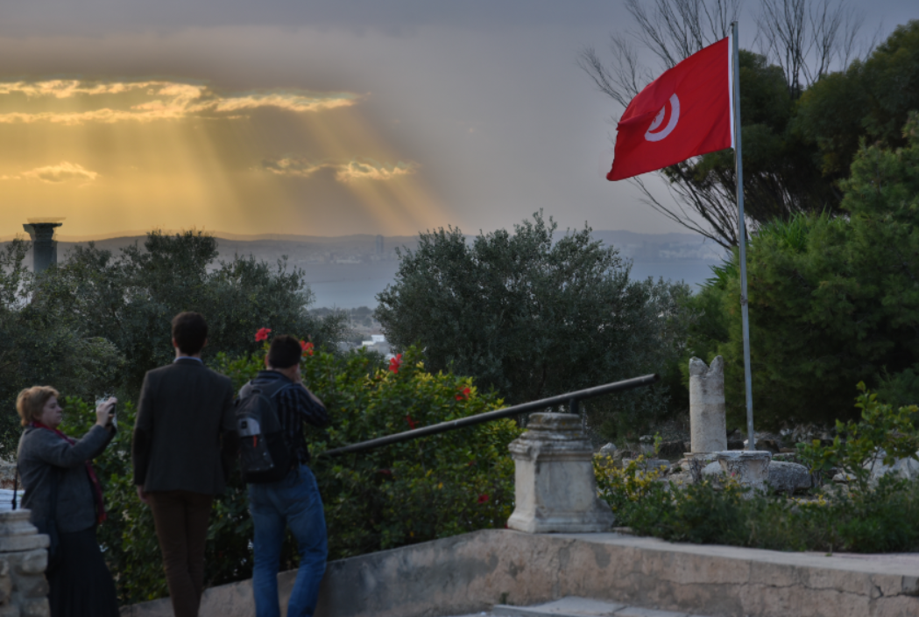
Learning and Performance Support Systems
Brièvement
Programme Systèmes d’aide à l’apprentissage et au rendement (SAAR)
Stephen Downes
OIF, Carthage Tunisia
20 Nov 2015
http://www.nrc-cnrc.gc.ca/fra/solutions/collaboration/saar.html

Slide 2
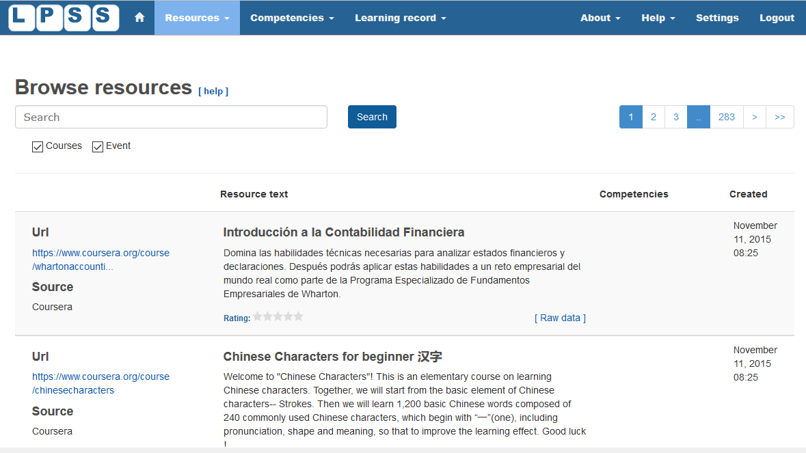
http://LPSS.ME

Slide 3
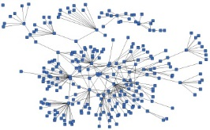
LPSS is Built Around the Personal Learning Record
fiche d'apprentissage personnel
This is a new type of data – we call it the personal graph.
Me
Each person has their own private personal graph.

Slide 4
Personal Learning Record
RELs
OERs
Fiche d'apprentissage personnel
Portfolio, artifacts and evidence
Badges, certificates, credentials, competencies
Activity Record - LRS
The PLR contains all a person’s learning records, including:
certificates, badges and credentials
activity records, test results, scores
Assignments, papers, drawings, things they create
PLR

Slide 5
LPSS infrastructure
Creations Go Out
Resources Come In
RELs
Learning Activities
I read and watch stuff
I play with toys
I make stuff
Things, Properties, Relations
Resource Repository Network
Things I did
Stuff I make
Big stuff goes here
Me
Questions
Personal Library
Pictures
Books
Movies
Answers
Learning Analytics Services

Slide 6
Resource Repository Network
Réseau de ressources
Personal
Context
Article
Photograph
Video
Person
Author
Publisher
Organization
Job Opportunity
Competency
Cetrificate
Event
Location / Place
Time / Date
Email
RSS
OAI
Sharepoint
Facebook
Twitter
Monster
Government
Repositories
Desire2Learn
Coursera
EdX
etc
Parsing
Scraping
Analytics
etc
RELs
Storage
RELATIONS

Slide 7
LPSS & MOOCs
RELs
MOOC3
MOOC1
EdX
Coursera
Blogger
MOOC2
RELs
Blackboard
LPSS
Facebook

Slide 8
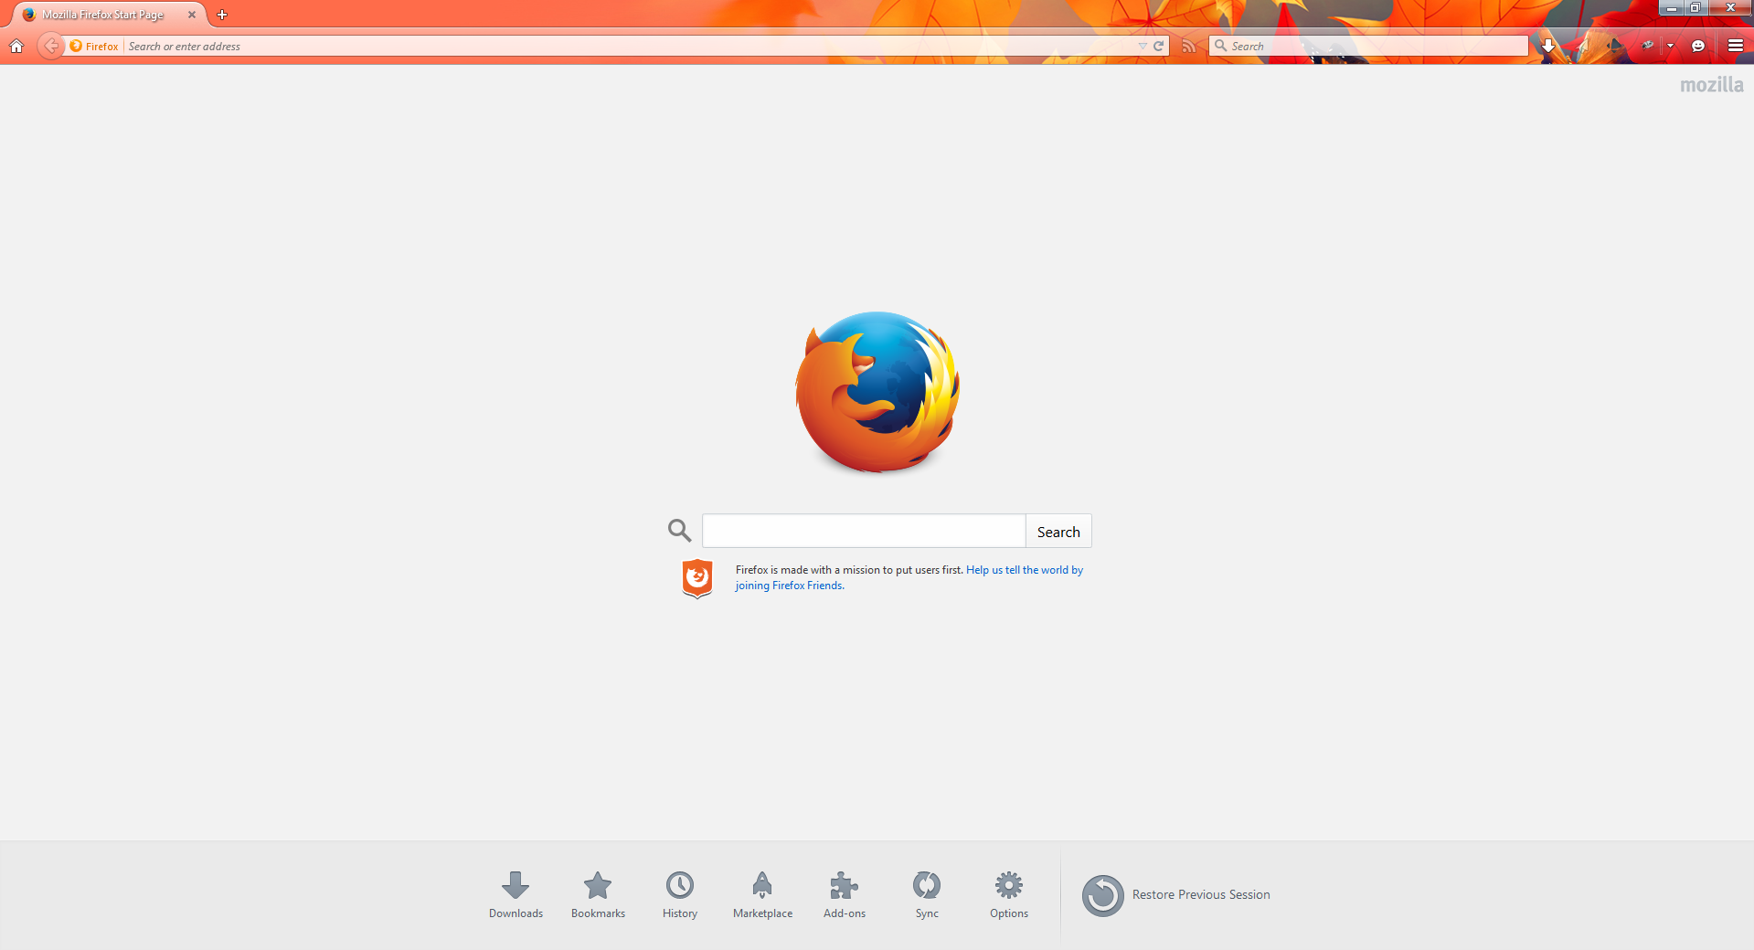
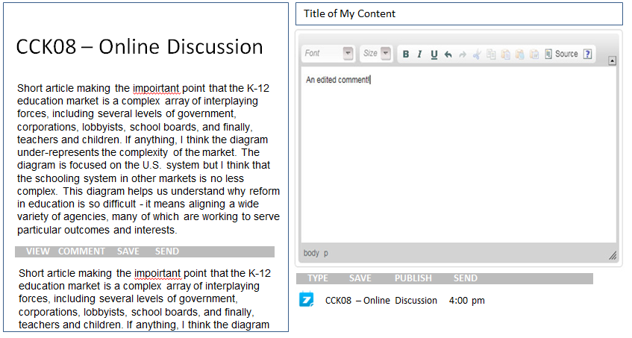
LPSS
Today
Read and Write in the Same Environment

Slide 9
LPSS
Today
Online Access to Learning Resources and Services

Slide 10
LPSS
Today
Learn While Connected to a Learning Community

Slide 11
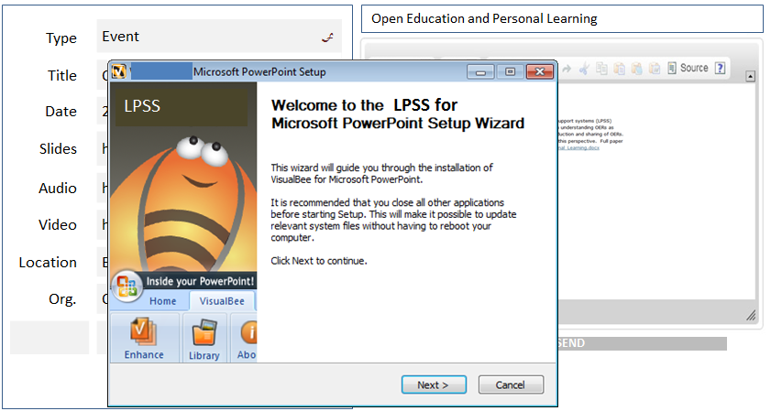
LPSS
Today
Use LPSs in both Learning and Workplace Environments

Slide 12
Analytics and Big Data
Analytique
Facebook
Twitter
EdX
Coursera
YouTube
Blackboard
Email
etc
peu profond
Tells us about the platform
profond
Tells us about the person

Slide 13
OIF – MOOC-REL
http://rel2014.mooc.ca/

Slide 14
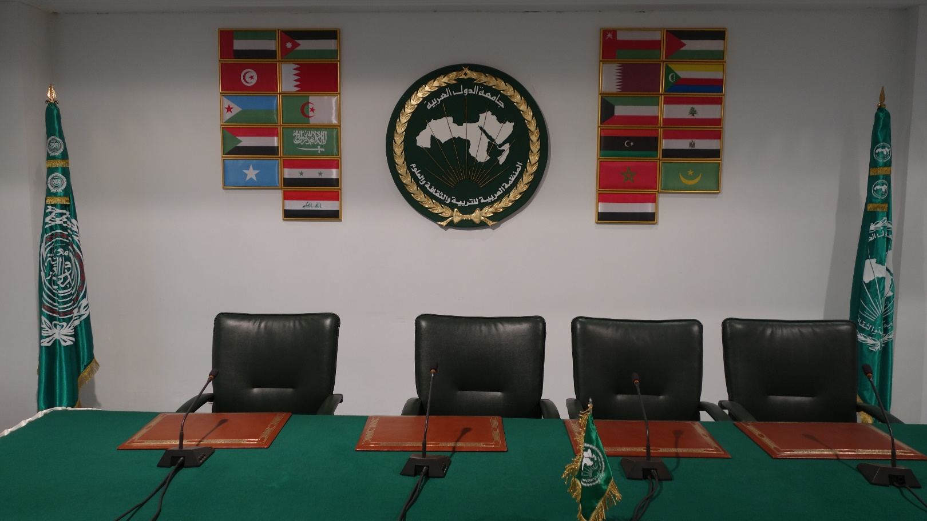
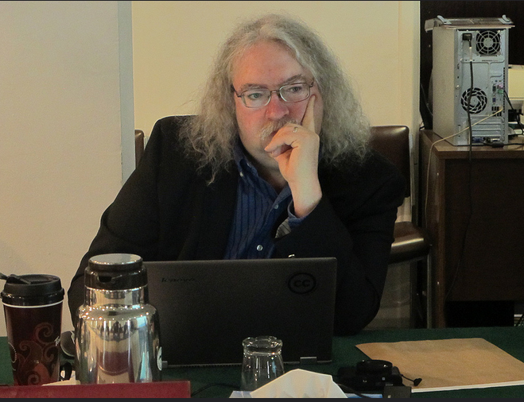
ALECSO – Capacity Building
http://www.downes.ca/presentation/337

Slide 15
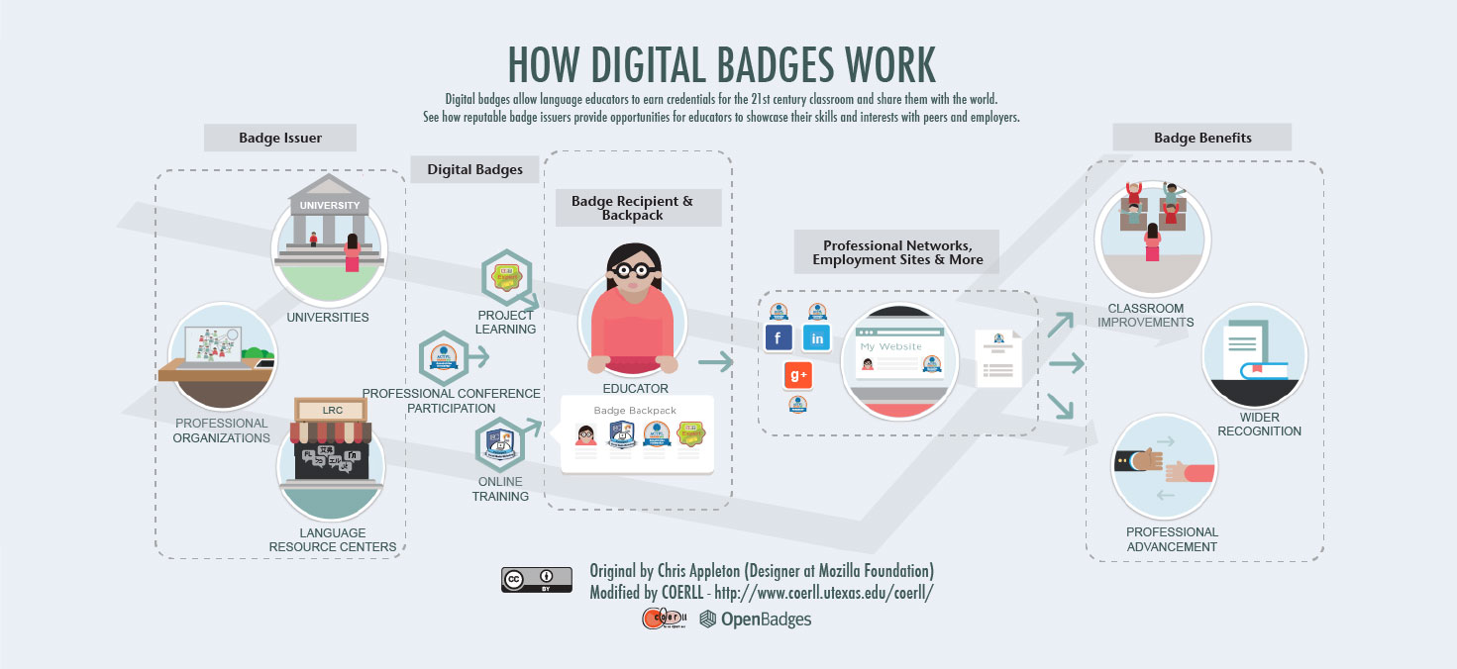
PCO Badges for Learning
http://www.downes.ca/post/63738

Slide 16
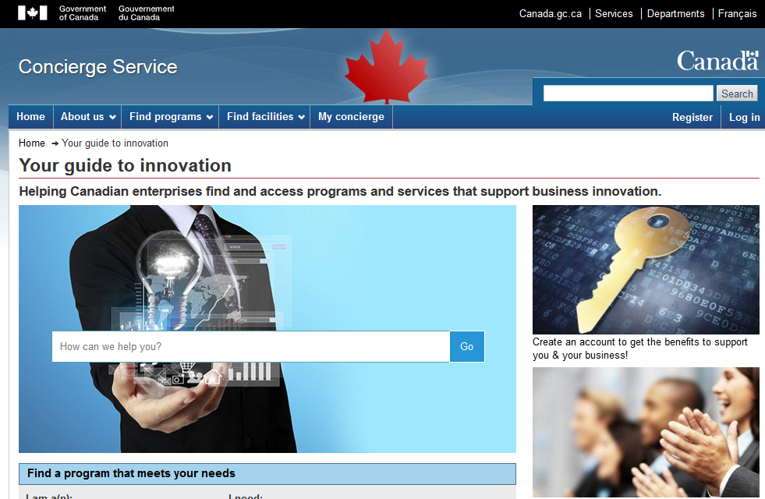
Concierge OMS
https://concierge.portal.gc.ca/

Slide 17
Expanding LPSS
Nouveaux projets
$20 Million Investment
NRC Technologies
Development Environment
$x + $y
Project
NRC
Funder
$y
Partner
University
Government
Development Agency
Foundation
UNESCO / UN
Corporate Partner
$x

Slide 18
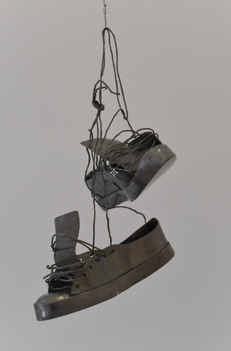
Possible Projects…
OERs, Repositories, Marketplaces
Badges, Credentials, Recognition
Simulations & Workplace Support
Matching People to Opportunities
http://LPSS.ME

Slide 19
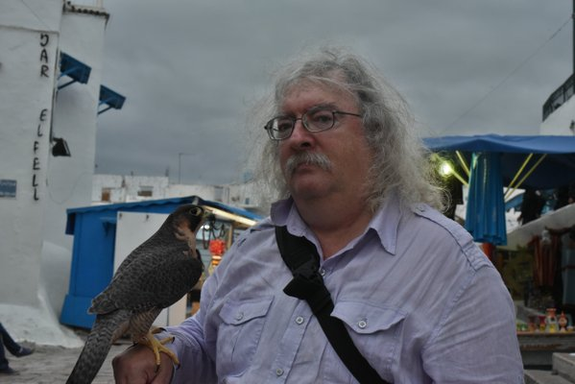
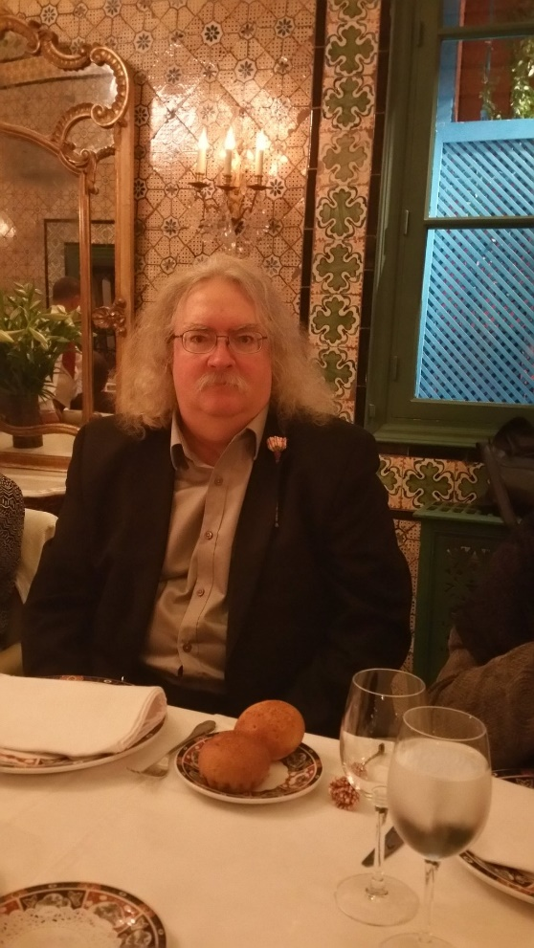
Stephen Downes
http://www.downes.ca

